Slide 1
Synthetic Data for Chart Creation
Goals
To generate a complete end to end scripting system for creating instances of charts using standard chart and graph generation tools

Slide 2
Overview
Outputs
Inputs
Existing
Structured Input Data
Script Configuration
Files (JSONs)
Intermediate
Code
Data Normalization Script
Chart SVG
SynChart Script
GTChart
Script
Normalized Chart Data
(CSVs)
Chart GT
(JSON)
Chart Image
(PNG)
Matplotlib Graph Library
Process
Data
Input / Output

Slide 3
SynGraph Folder Configuration
Global.config //config file used
NameOfRun/
SynChart_YYMMDD_HHMMSS/
SynChart.config //config file used
SynChart.log // log of all charts generated
Chart1/
.png, -gt.json, .svg
Chart2/

Slide 4
Configurable Parameters (as per paper)
Position of title, legends and legend entries,
Font families and sizes,
Style (color, width of line, borders, grids, and markers)
Bar widths and/or inner/outer radii of pie
Addition of optional elements such as error bars

Slide 5
Code Structure (.py code)
# importing matplotlib module
from matplotlib import pyplot as plt
x = [5, 2, 9, 4, 7] # Independent variable
y = [10, 5, 8, 4, 2] #dependent variable
# Function to plot line graph
plt.plot(x,y)
plt.savefig("line.png"); plt.clf();
# Function to plot bar graph
plt.bar(x,y)
plt.savefig("bar.png") plt.clf();
# Function to plot histogram
plt.hist(y);
plt.savefig("histogram.png") plt.clf();
# Function to plot scatter
plt.scatter(x, y)
plt.savefig("scatter.png") plt.clf();

Slide 6
MatplotLib Taxonomy
Documentation: https://matplotlib.org/3.1.1/contents.html

Slide 7
Script Configuration
The Script Configuration was moved to a document:
https://docs.google.com/document/d/1pxwlO6Om5oAIzfgQBkFnfaZgKc8lACofa_LJmxNTVSI/edit

Slide 8
Some MatplotLib options
Axes and Tick Marks:
https://www.geeksforgeeks.org/python-matplotlib-pyplot-ticks/
https://matplotlib.org/3.1.0/gallery/ticks_and_spines/major_minor_demo.html

Slide 9
Script Configuration (JSON format)
{
"chart_type": ["line","bar"],
"independent_variable":[2,3,4,5,6,7],
"dependent_variable":[10,20,30,40,50,60],
"x_ticks" : ["T1", "T2", "T3", "T4", "T5","T6"],
"y_ticks" : ["P1", "P2", "P3", "P4", "P5","P6"],
"line_style" : "dashed",
"line_width" : 7.5,
"bar_width" : 0.8,
"color": "green",
"chart_title" : "Volume Change",
"font_size" : 10
}

Slide 10
Ground Truth
Looks like there are some classes to help with ground truth
https://matplotlib.org/3.1.1/api/axes_api.html
https://matplotlib.org/3.1.1/api/_as_gen/matplotlib.axis.Axis.get_ticklocs.html#matplotlib.axis.Axis.get_ticklocs

Slide 11
Normalized Chart Data (CSV) Format
The output of chart normalization will be a CSV/Excel File with at least two columns.
Column will be the independent variable
Columns 2-N will be the dependent variables
Example
Points Scored
Team | 1,2,3,4
Period | 0,25,50,75,100
Team | Period 1 | Period 2
Team 1 | 24 | 89
Team 2 | 36 | 24
Team 3 | 12 | 37
Team 4 | 38 | 63
Graph Title
I | D1 | D2 | D3
1
2
3
4

Slide 12
Graph Title
I-Axis Title | {I-Axis Labels, …} | ...
D-Axis TItle | {D-Axis Labels, …} | ...
I-Data Label | D1-Data Label | D2-Data Label | D3-Data Label
1
2
3
4

Slide 13
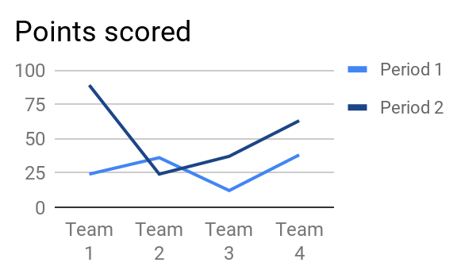
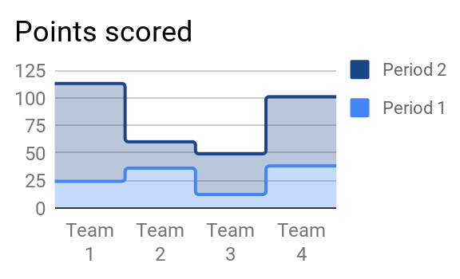
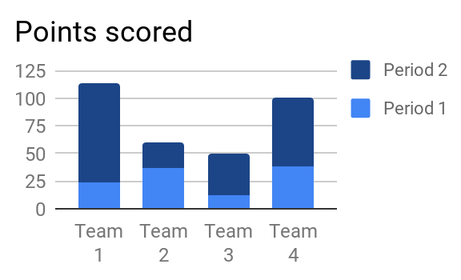
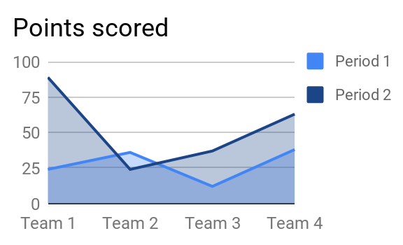
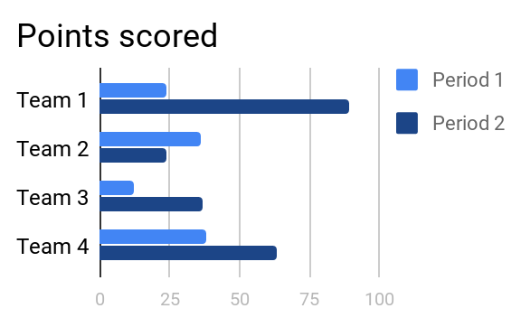
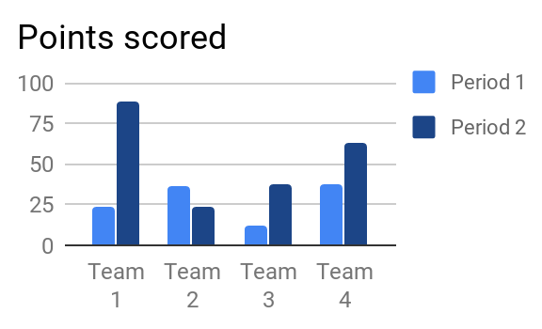
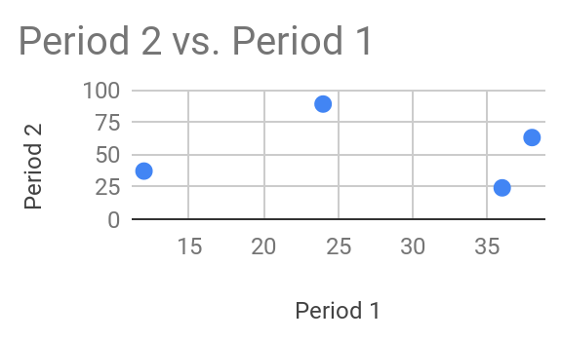
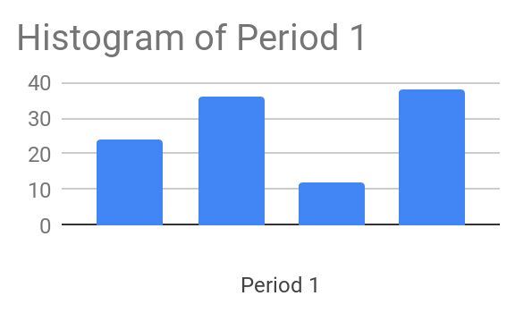
Examples - all from the same underlying data

Slide 14
Chart GT (JSON) Format

